Slide 1

Exploratory Data Analysis on Credit Card Dataset
Name: Reethika Batch: 467

Slide 2
Overview of the Project Agenda:
Introduction
Dataset Overview
Data Cleaning & Preparation
Univariate Analysis
Bivariate Analysis
Non-Visual Analysis
Insights & Conclusion

Slide 3
Introduction
Credit card data contains customer spending, payment, and credit usage information.
This project focuses on performing Exploratory Data Analysis (EDA) to understand customer financial behavior.
The goal is to clean the raw data and extract meaningful insights using statistical and analytical techniques.

Slide 4
Why This Project?
Why I Chose This Dataset
Credit card analysis is a real-world financial problem
Highly relevant to:
Banking sector
Financial risk analysis
Customer behavior analysis
Helps understand:
Spending patterns
Payment behavior
Credit utilization
Strengthens EDA and data cleaning skills, important for interviews

Slide 5
Understanding the Dataset
Dataset Details
Dataset Type: Credit Card Default Data
Records: ~150,000 rows
Features: 18 columns
Data Types: Numerical & Categorical
Key Columns
NPA Status – Non-performing asset indicator
RevolvingUtilizationOfUnsecuredLines – Credit usage ratio
Age – Customer age
MonthlyIncome – Customer income
DebtRatio – Debt to income ratio
Late Payment Variables – 30–59, 60–89, 90 days past due
Good_Bad – Customer classification
Initial Observations
Missing values present in income-related columns
Mixed data types (numerical & categorical)
Presence of extreme values (outliers)

Slide 6
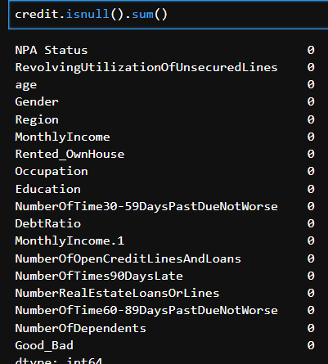
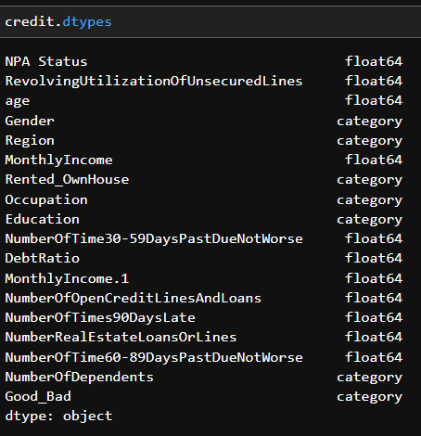
Data Cleaning & Preparation
Libraries Used:
Pandas – Data loading and manipulation
NumPy – Numerical operations
Matplotlib – Data visualization
Seaborn – Statistical plots
Checked dataset shape and structure
Null Values Checking
Missing values were identified in columns such as MonthlyIncome
and NumberOfDependents. These null values were handled to maintain
consistency and reduce bias in analysis.
Duplicate Values Checking
Duplicate records were checked across the dataset. No major duplicate rows were found, ensuring each customer record is unique.
Data Type Verification
Numerical and categorical columns were verified and corrected where required. This ensured accurate calculations and proper visualizations during analysis.

Slide 7
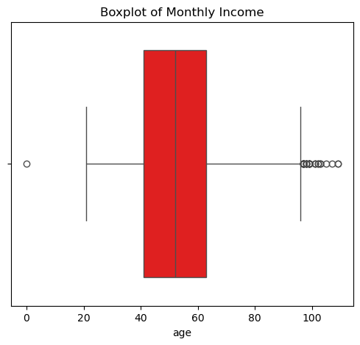
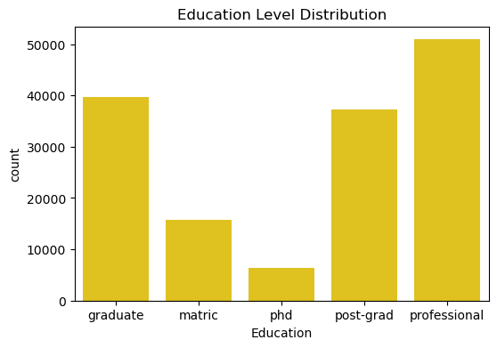
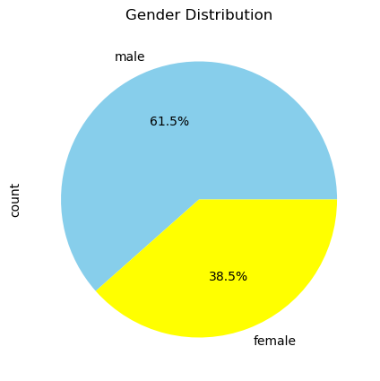
Univariate Analysis
Analysis of a single variable to understand its distribution and characteristics.
Plots Used
Pie Chart – for categorical variable distribution
Box Plot – for numerical variable analysis
Count Plot – frequency of categorical variables

Slide 8
Key Observations:
Box Plot (Monthly Income)
Monthly income shows the presence of several outliers on the higher end
The distribution is right-skewed, indicating few high-income customers
Count Plot (Education Level Distribution)
Professional and Graduate categories have the highest number of customer.
Education levels are unevenly distributed across the dataset
Pie Chart (Gender Distribution)
Male customers constitute a larger proportion (≈61.5%)
Female customers account for ≈38.5%
The dataset shows a gender imbalance

Slide 9
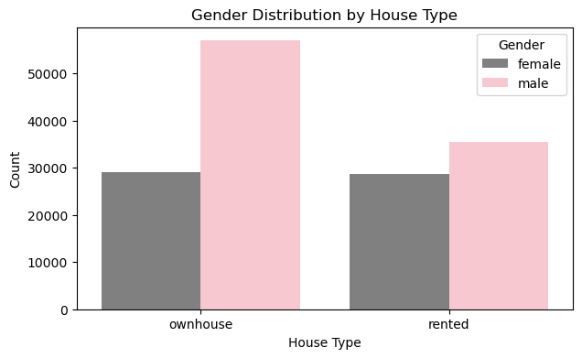
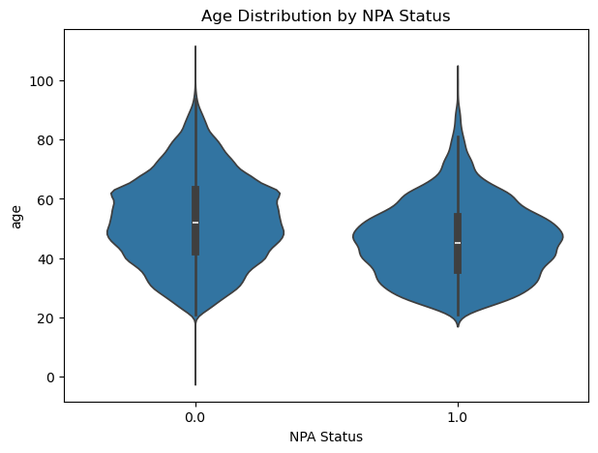
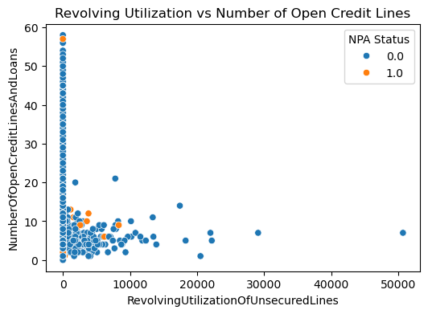
Bivariate Analysis
Analysis of the relationship between two variables to identify patterns or associations.
Plots Used
Count Plot – Categorical vs Categorical
Violin Plot – Categorical vs Numerical
Scatter Plot – Numerical vs Numerical

Slide 10
Key Observations:
Categorical vs Categorical (Gender vs House Type)
Male customers are more in number compared to female customers in both own-house and rented categories
Customers living in their own house are more than rented house customers
Categorical vs Numerical (Age vs NPA Status)
Customers with non-NPA status are mostly concentrated in the middle-age group
Age alone does not strongly determine NPA status but shows visible variation
Numerical vs Numerical (Revolving Utilization vs Open Credit Lines)
Higher revolving utilization is mostly associated with fewer open credit lines
Customers with NPA status show higher utilization at lower credit line counts

Slide 11
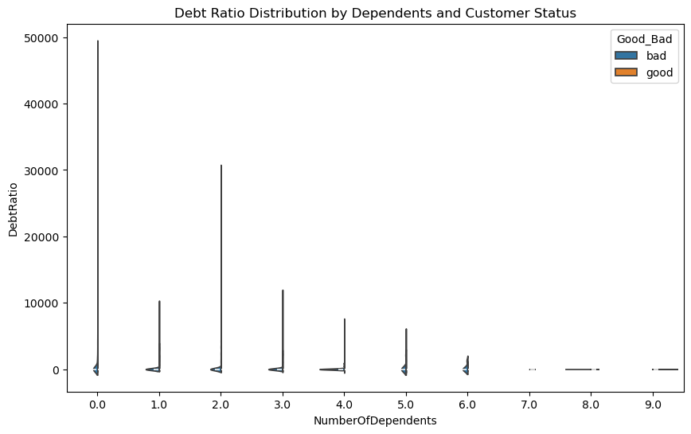
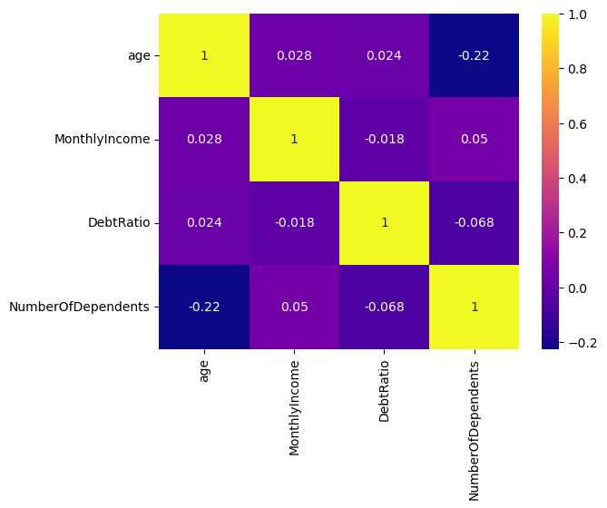
Multivariate Analysis
Multivariate analysis involves three or more variables analyzed together to understand complex interactions.
Graphs Used
Correlation Heatmap
Violin Plot

Slide 12
Correlation Heatmap
Age shows very weak correlation with MonthlyIncome and DebtRatio
DebtRatio has weak correlation with MonthlyIncome
NumberOfDependents shows a negative correlation with Age
Overall, no strong linear relationship exists among these variables, indicating complex interactions
Violin Plot
Bad customers show higher and more spread-out DebtRatio values compared to good customers
As number of dependents increases, DebtRatio distribution becomes more concentrated
Clear difference in distribution is observed between good and bad customers

Slide 13
Insights
Most customers are good customers (non-NPA)
Some customers have very high debt compared to their income.
Customers who delay payments often are more likely to become NPA.
Income alone does not decide risk; spending and payment behavior matter more.
Credit risk depends on multiple factors together, not just one.
Conclusion
This project performed Exploratory Data Analysis on a credit card dataset to understand customer behavior and credit risk.
After cleaning the data, univariate, bivariate, and multivariate analyses were carried out to identify important patterns.
The analysis shows that debt ratio, credit utilization, and late payment behavior play a major role in determining customer risk, while income alone is not a strong indicator.

Slide 14

THANK YOU

